Slide 1
Lab 1
Recreating a correct Producer/Consumer Solution
NEU – Dec 2018

Slide 2
Lab #1 – 12/12
Goal: Correctly code a bounded multi-threaded producer-consumer solution which avoids deadlock
Options
Java – Utilize Java.util.concurrent.Semaphore
https://www.geeksforgeeks.org/java-util-concurrent-semaphore-class-java/
https://www.geeksforgeeks.org/semaphore-in-java/
C++ 11 standard includes built-in support for threads and conditional variables!
http://en.cppreference.com/w/cpp/thread/mutex
https://en.cppreference.com/w/cpp/thread/condition_variable
YOU MUST ENABLE C++ 11 compiler flags in CodeBlocks for this to work!!!!!!
Either globally or per project if you’re in a project

Slide 3
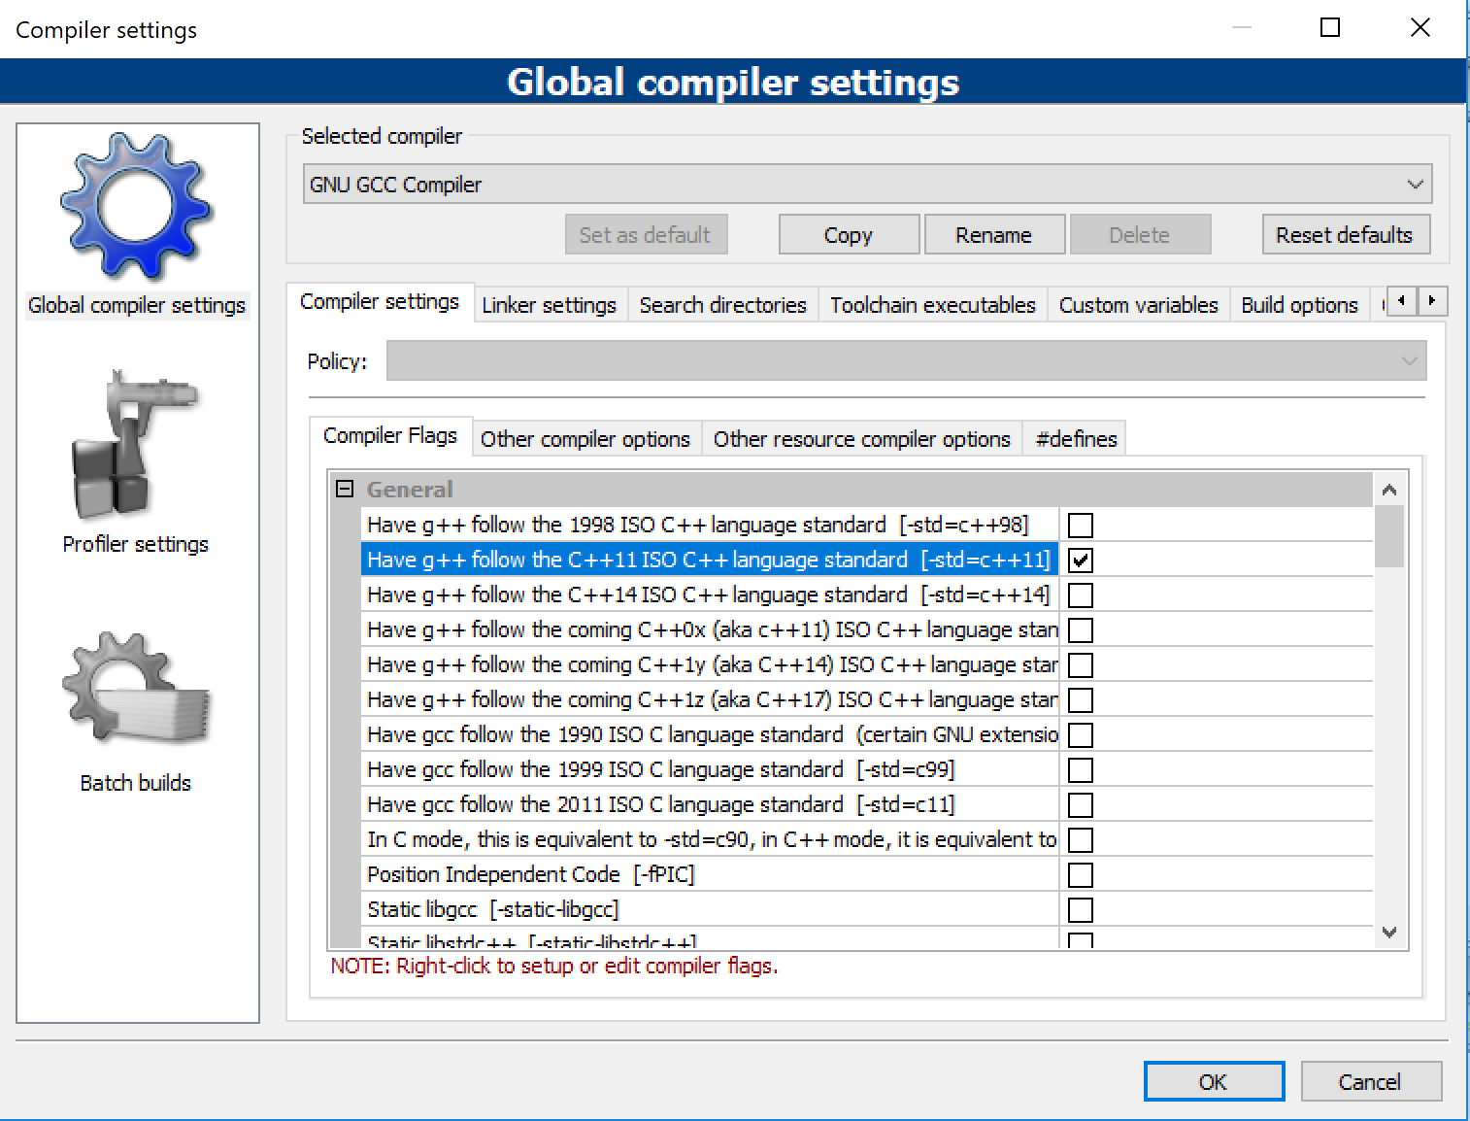
CodeBlocks with C++11

Slide 4
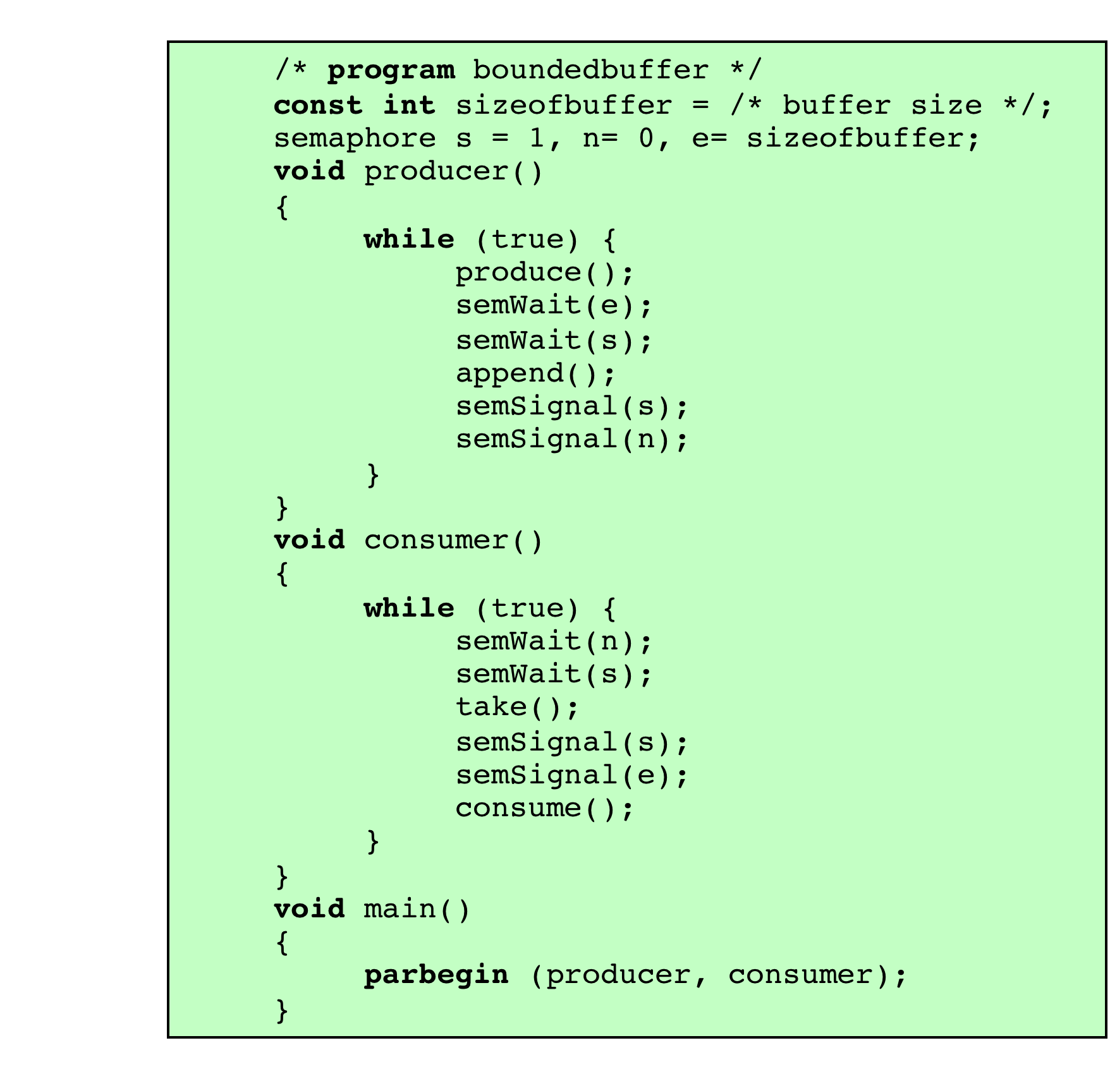
Example algorithm using semaphores
Notes:
Figure 5.13 shows a solution using general semaphores. The semaphore e has been added to keep track of the number of empty spaces.

Slide 5
Lab Requirements
Before: Go through reference code, design/select algorithm(s)
During: Program, debug, test
Utilize sleep commands to help visualize testing
Deliverable: Documented Source Code
How are you ensuring upper/lower bounds?
How are you preventing deadlock?
How are you protecting critical sections?
Conclusions, comments, suggestions
Submit: Documented Source Code in Blackboard by midnight 12/16

Slide 6
Additional Considerations
Add sleep commands (random 0~2 sec)
This should allow/force the interleaving of processes
Cap the number of productions & consumptions (should be equal so it will terminate)

Slide 7
Lab Evaluation
Can you correctly handle
Multiple producers/multiple consumers?
Avoiding Race Conditions
No going below lower bound
No going above upper bound
Protecting the critical section/shared variables
Avoiding Deadlock

